Slide 1
Creating Dashboards and Storyboard with Tableau
Sundharakumar KB
Department of Computer Science and Engineering
School of Engineering
Shiv Nadar University Chennai

Slide 2
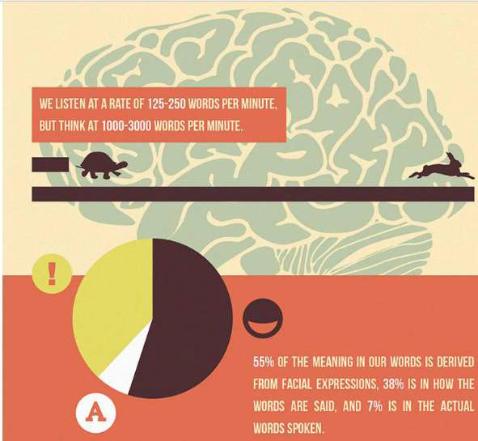
Introduction

Slide 3

Types of visualization - Exploratory – Look at the data from various perceptions

Slide 4
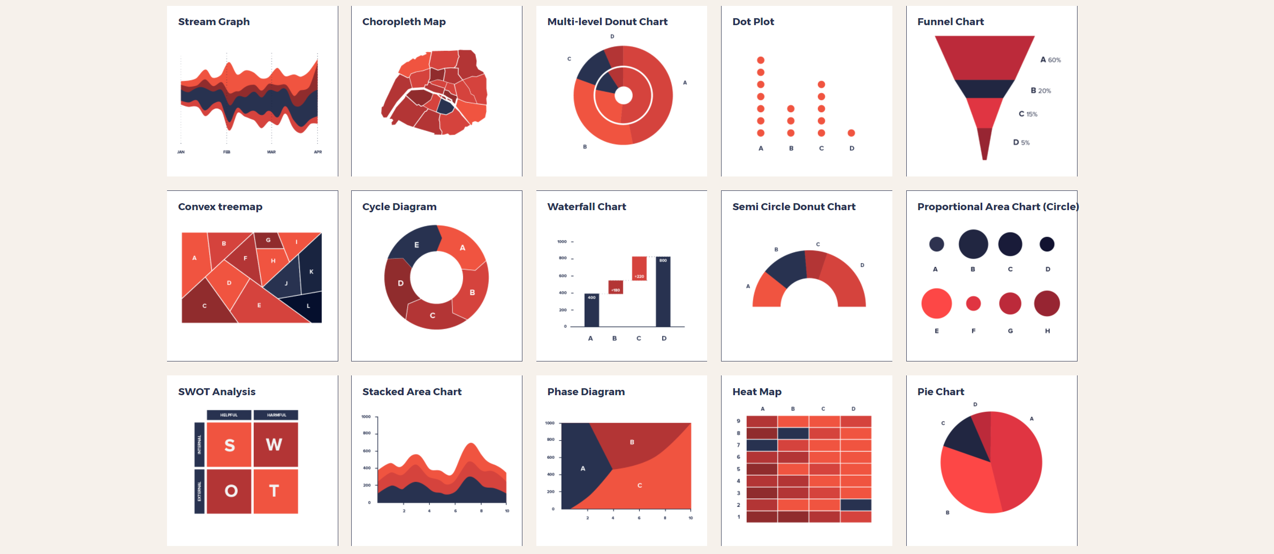
Explanatory – First find out who is the audience and create visuals accordingly.

Slide 5
Visual analytics (1/2)
Understand Cognitive perception
Leverage strengths of our brain
Eliminate visual clutter
Focus on the business insight
Choose appropriate display mechanism
Graph types to match the message
Design dashboards
Solve business question easily

Slide 6
Visual analytics (2/2)
Explore visually
Systematic process to generate insights
Analyze visually
Techniques to extract meaning from large data sets
Create storyboards
Transform complex data into information

Slide 7
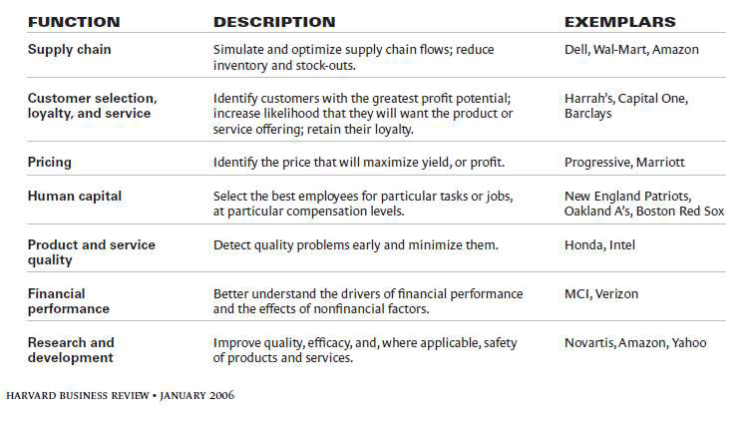
Domains and their descriptions

Slide 8
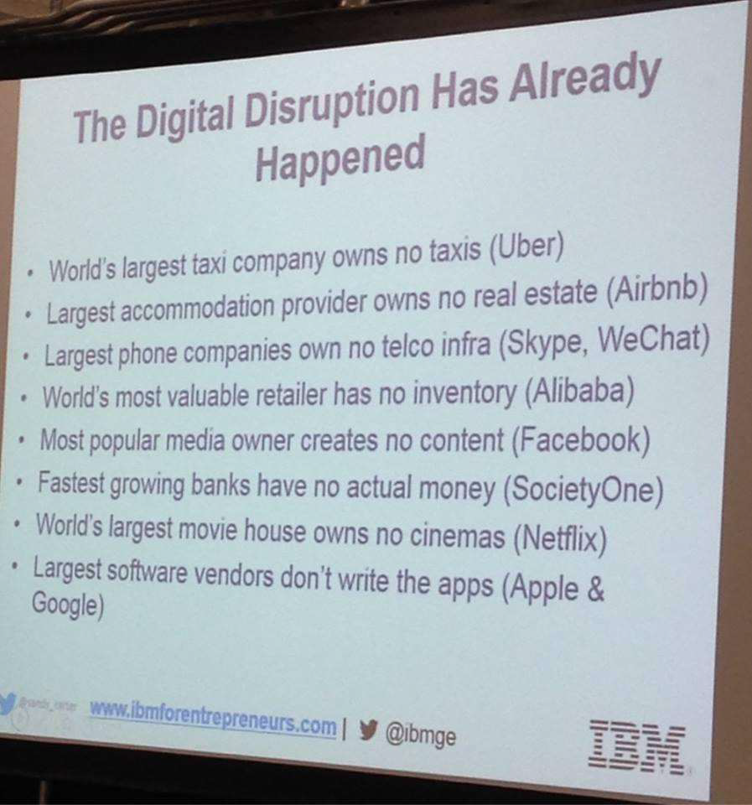
Digital disruption

Slide 9
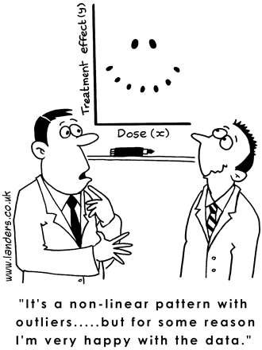
Understanding the patterns in the data

Slide 10
Data visualization and insights
Visualization
is the representation and presentation of data that exploits our visual perception abilities in order to amplify cognition.
Insights
is the discovery of non-trivial, complex, deep, unexpected or relevant truths about information.

Slide 11
analyst… who?
Reporting and Visualization tools
Visual Discovery and Story Telling
Statistical/Machine Learning Models

Slide 12
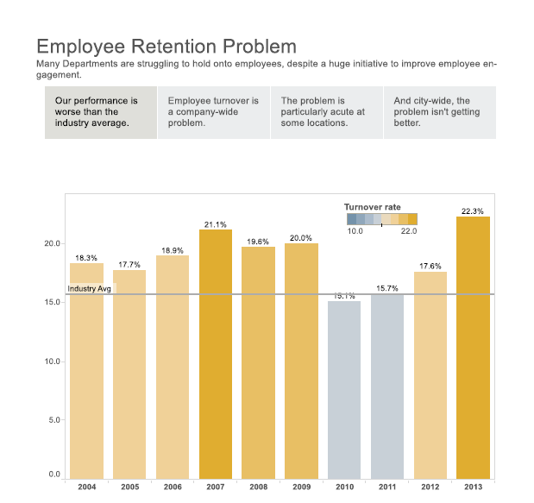
Story example

Slide 13
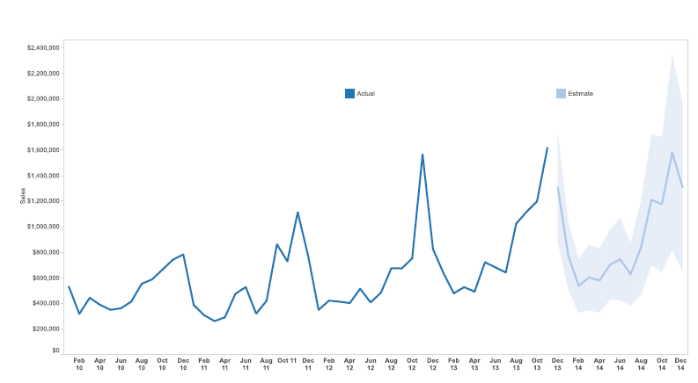
Statistical/ml techniques

Slide 14
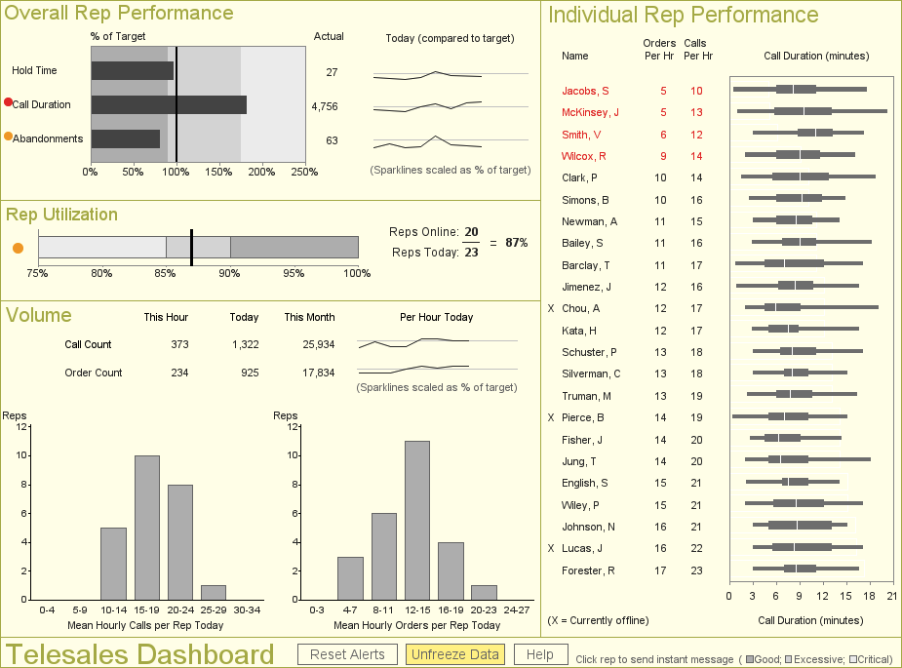
Most people agree to this as data visualization

Slide 15
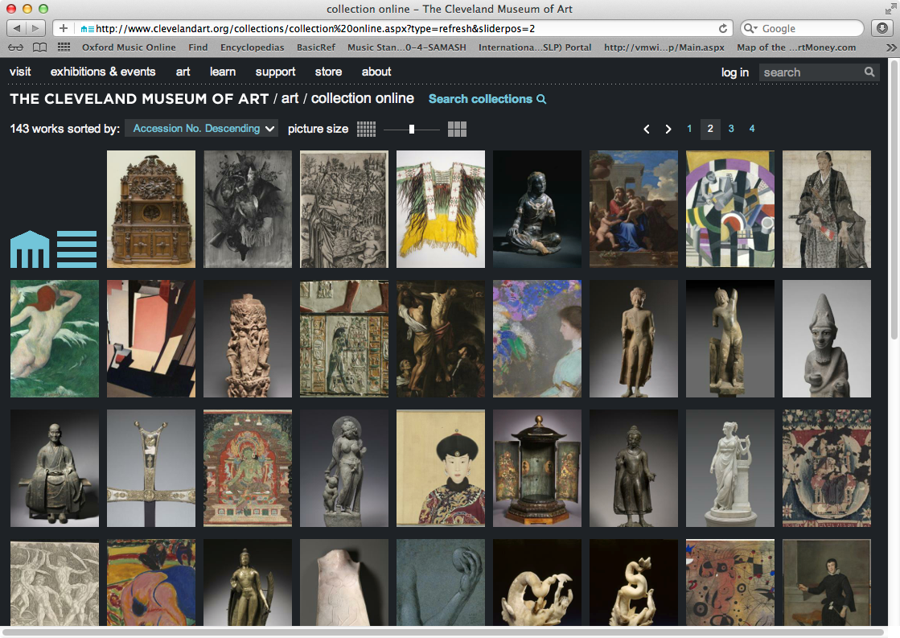
This?

Slide 16
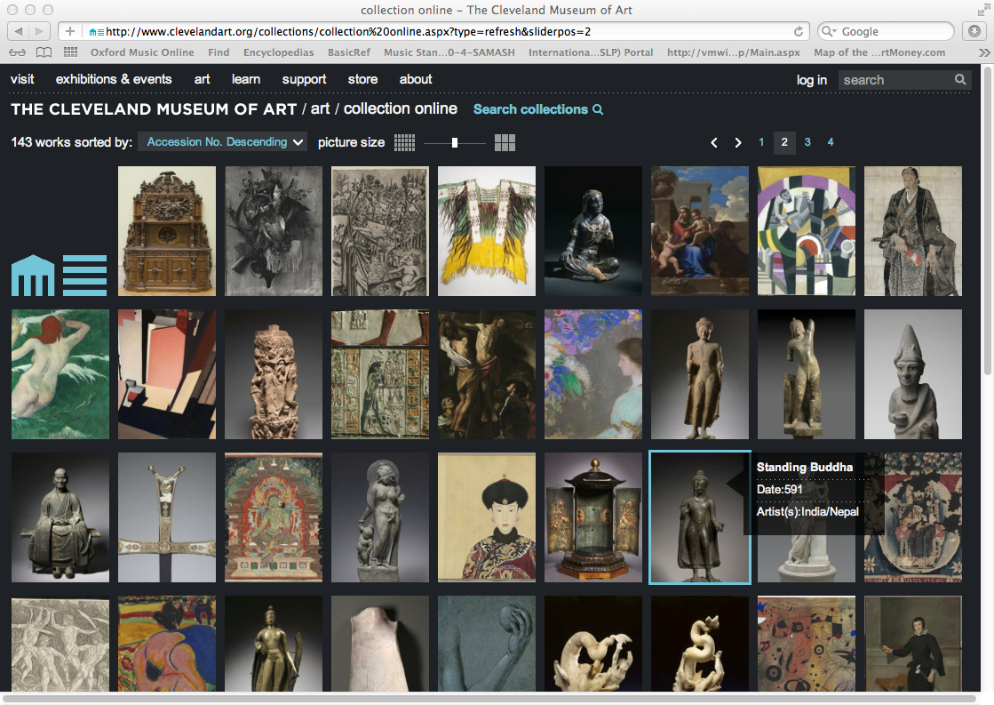
This?

Slide 17

Drill down

Slide 18

Further Drill Down

Slide 19

What can you see?

Slide 20
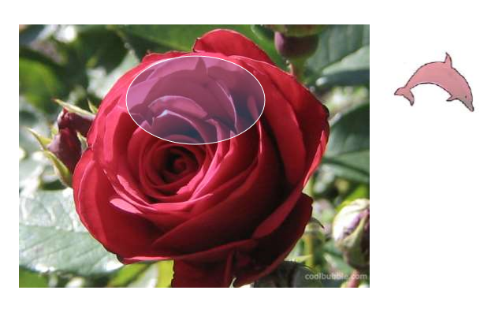

Slide 21
Can you see now?

Slide 22
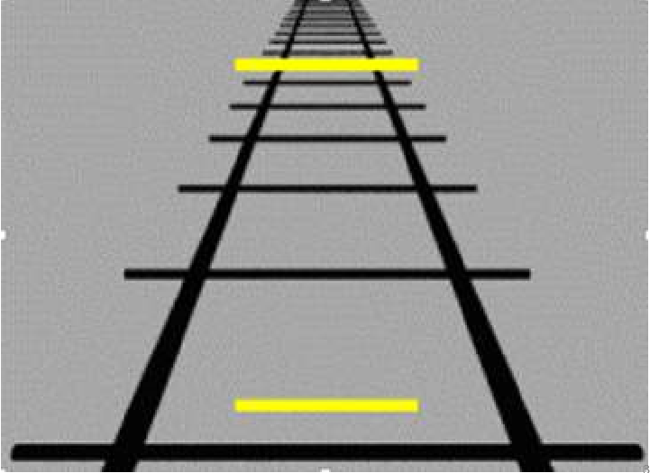
Visual Perception

Slide 23
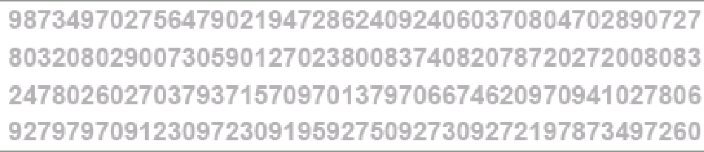
Count the number of 5s

Slide 24
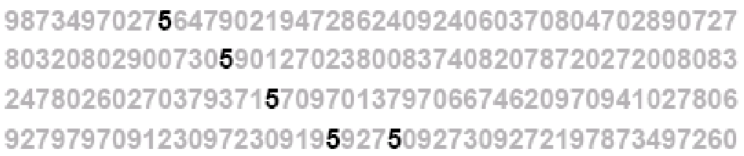
Serial and parallel processing

Slide 25
HMUAN MNID
The phaonmneal pweor of the hmuan mnid, aoccdrnig to a rscheearch at Cmabrigde Uinervtisy, it dseno't mtaetr in waht oerdr the ltteres in a wrod are, the olny iproamtnt tihng is taht the frsit and lsat ltteer be in the rghit pclae. The rset can be a taotl mses and you can sitll raed it whotuit a pboerlm. Tihs is bcuseae the huamn mnid deos not raed ervey lteter by istlef, but the wrod as a wlohe. Azanmig huh? yaeh and I awlyas tghuhot slpeling was ipmorantt!

Slide 26


Slide 27


Slide 28


Slide 29


Slide 30
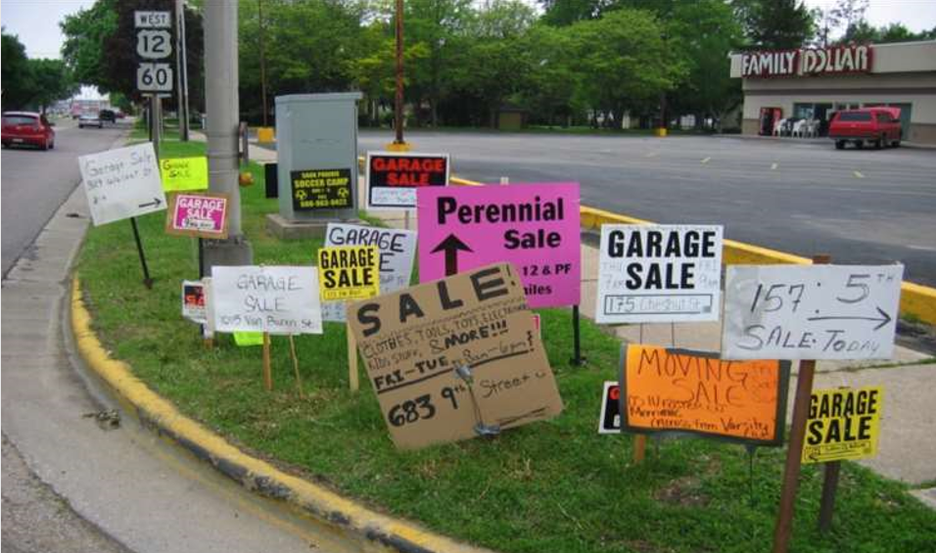

Slide 31
5 questions to ask yourself before starting to visualize
Who is my audience?
What is the main idea I need to convey to my audience
What is the story of my report
Am I using my audience’s language
What output is right for my audience

Slide 32
Pre-attentive attributes
Pre-attentive attributes are those which determine what information captures users’ attention.
Pre-attentive processing occurs without our consciousness at an extremely high speed. It is tuned to detect a specific set of visual attributes.
There are 4 categories of pre-attentive visual attributes:
Form
Colour
Spatial Position
Movement

Slide 33
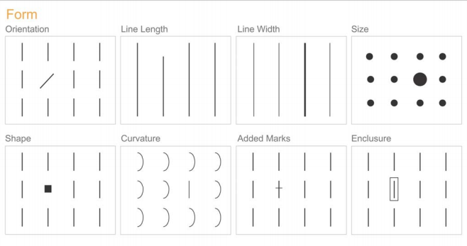
form

Slide 34
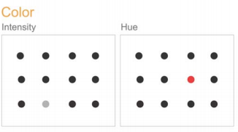
color

Slide 35
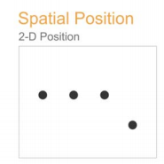
Spatial position

Slide 36
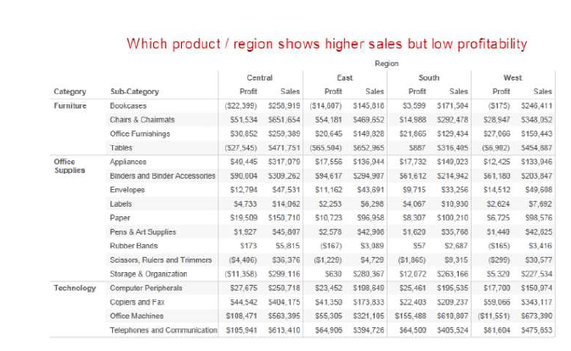
Descriptive data

Slide 37
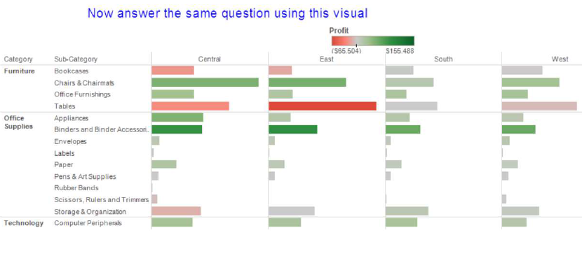
Using the Pre-attentive attributes

Slide 38
Choosing chart based on data types
Bar Chart :
Compare
Category
Rank
High/Low
Correlation

Slide 39
Choosing chart based on data types
Scatter Plot:
Trend
Concentrations
Gaps
Outliers (Box plot)
Groups/Clusters
Relationship

Slide 40
Choosing chart based on data types
Pie Chart
Part-to-whole
Angles not difficult to interpret
Constrained for space (Geo Spatial)
Large volume of data (bubble chart)

Slide 41
Choosing chart based on data types
Line Charts
Trend
Straightforward
Pattern
Sequence
Seasonality
Time

Slide 42
Introduction

Slide 43
Types of visualization - Exploratory – Look at the data from various perceptions

Slide 44
Explanatory – First find out who is the audience and create visuals accordingly.

Slide 45
Visual analytics (1/2)
Understand Cognitive perception
Leverage strengths of our brain
Eliminate visual clutter
Focus on the business insight
Choose appropriate display mechanism
Graph types to match the message
Design dashboards
Solve business question easily

Slide 46
Visual analytics (2/2)
Explore visually
Systematic process to generate insights
Analyze visually
Techniques to extract meaning from large data sets
Create storyboards
Transform complex data into information

Slide 47
Domains and their descriptions

Slide 48
Digital disruption

Slide 49
Understanding the patterns in the data

Slide 50
Data visualization and insights
Visualization
is the representation and presentation of data that exploits our visual perception abilities in order to amplify cognition.
Insights
is the discovery of non-trivial, complex, deep, unexpected or relevant truths about information.

Slide 51
analyst… who?
Reporting and Visualization tools
Visual Discovery and Story Telling
Statistical/Machine Learning Models

Slide 52
Story example

Slide 53
Statistical/ml techniques

Slide 54
Most people agree to this as data visualization

Slide 55
This?

Slide 56
This?

Slide 57
Drill down

Slide 58
Further Drill Down

Slide 59
What can you see?

Slide 61
Can you see now?

Slide 62
Visual Perception

Slide 63
Count the number of 5s

Slide 64
Serial and parallel processing

Slide 65
HMUAN MNID
The phaonmneal pweor of the hmuan mnid, aoccdrnig to a rscheearch at Cmabrigde Uinervtisy, it dseno't mtaetr in waht oerdr the ltteres in a wrod are, the olny iproamtnt tihng is taht the frsit and lsat ltteer be in the rghit pclae. The rset can be a taotl mses and you can sitll raed it whotuit a pboerlm. Tihs is bcuseae the huamn mnid deos not raed ervey lteter by istlef, but the wrod as a wlohe. Azanmig huh? yaeh and I awlyas tghuhot slpeling was ipmorantt!

Slide 71
5 questions to ask yourself before starting to visualize
Who is my audience?
What is the main idea I need to convey to my audience
What is the story of my report
Am I using my audience’s language
What output is right for my audience

Slide 72
Pre-attentive attributes
Pre-attentive attributes are those which determine what information captures users’ attention.
Pre-attentive processing occurs without our consciousness at an extremely high speed. It is tuned to detect a specific set of visual attributes.
There are 4 categories of pre-attentive visual attributes:
Form
Colour
Spatial Position
Movement

Slide 73
form

Slide 74
color

Slide 75
Spatial position

Slide 76
Descriptive data

Slide 77
Using the Pre-attentive attributes

Slide 78
Choosing chart based on data types
Bar Chart :
Compare
Category
Rank
High/Low
Correlation

Slide 79
Choosing chart based on data types
Scatter Plot:
Trend
Concentrations
Gaps
Outliers (Box plot)
Groups/Clusters
Relationship

Slide 80
Choosing chart based on data types
Pie Chart
Part-to-whole
Angles not difficult to interpret
Constrained for space (Geo Spatial)
Large volume of data (bubble chart)

Slide 81
Choosing chart based on data types
Line Charts
Trend
Straightforward
Pattern
Sequence
Seasonality
Time

